Slide 1


Local Shape Editing at the Compositing Stage
Carlos J. Zubiaga, Gaël Guennebaud, Romain Vergne, Pascal Barla
Notes:
Local Shape editing is modification of normals, but not displacement of vertices

Slide 2
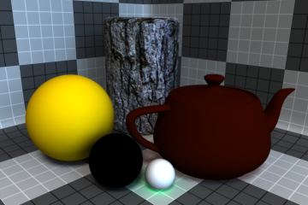
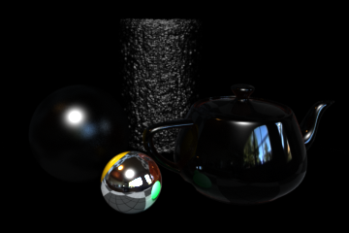
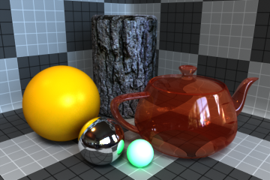
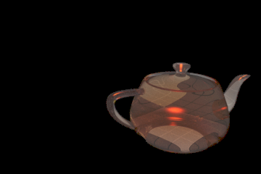
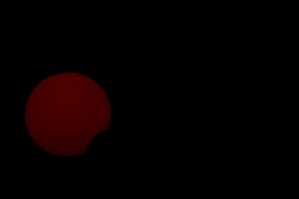

Compositing
Shading Buffers
Diffuse
Reflection
Final Image
∑
Transparent
Subsurface
Emission
Notes:
The result of a complex rendering can ge generated as
the combination of different shading components – Basic diffuse & Reflections (In which we focus our works)
and other complex shading like: Subsurface, Translucent or emission
Modern render engines outputs those components in separate buffers.
Permits to re-render specific component which reduces cost
Modulation of the the shading components is straight forward

Slide 3
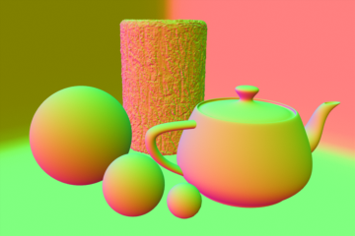
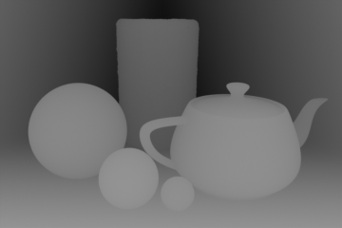
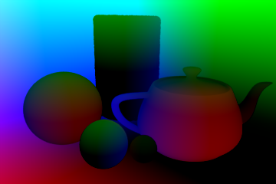
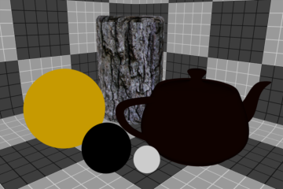
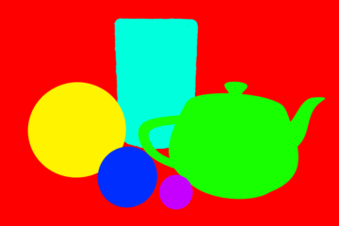
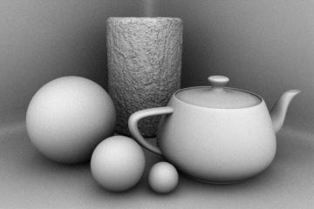
Compositing
Auxiliary Buffers
Shading Buffers
Diffuse
Reflection
Normals
Depth/Position
Diffuse Coeff.
Transparent
Subsurface
Object ID
Emission
Ambient Occ.
Notes:
Alongside with the shading buffers is possible to output additional information (normals, positions, Ids, occlusion maps..)
Those buffers are manily used for sebugging

Slide 4
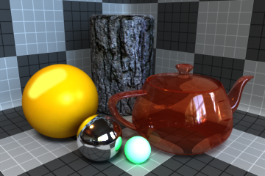
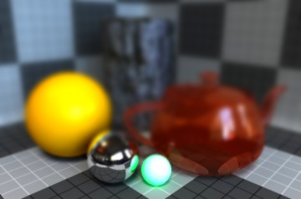
Compositing Effects
Shading Buffers
Auxiliary Buffers
Diffuse
Reflection
Normals
Depth/Position
Final Image
Relighting
DOF / Fog
Notes:
The can be used as well to add some effects to the Image
Normals can used add local lighting
Depth are used to make depth of field effects

Slide 5
Compositing Effects Limitations
Shading Buffers
Auxiliary Buffers
Diffuse
Reflection
Normals
Depth/Position
Shape modifications do not change shading
Lighting is lost in the rendering process
Costly re-rendering is needed
Notes:
The possible effects are limited
If we modify the geometry buffers (normal or position) we cannot produce a variation on shading
The lighting needed for the new normal is missed, as the whole lighting is missed in the rendering pipeline
The solution would be to re-render the scene

Slide 6
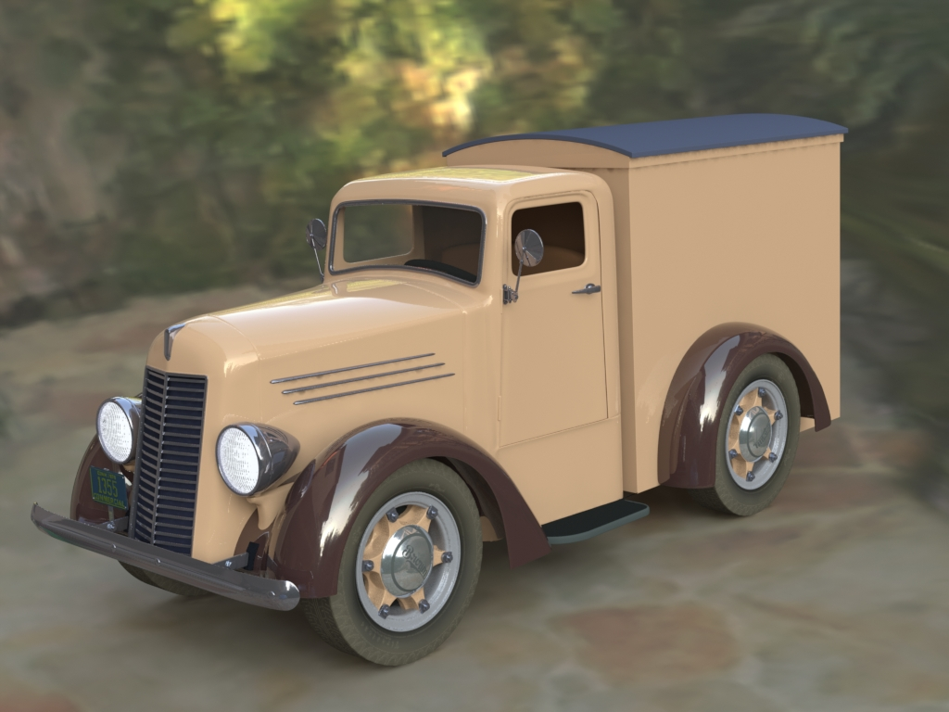
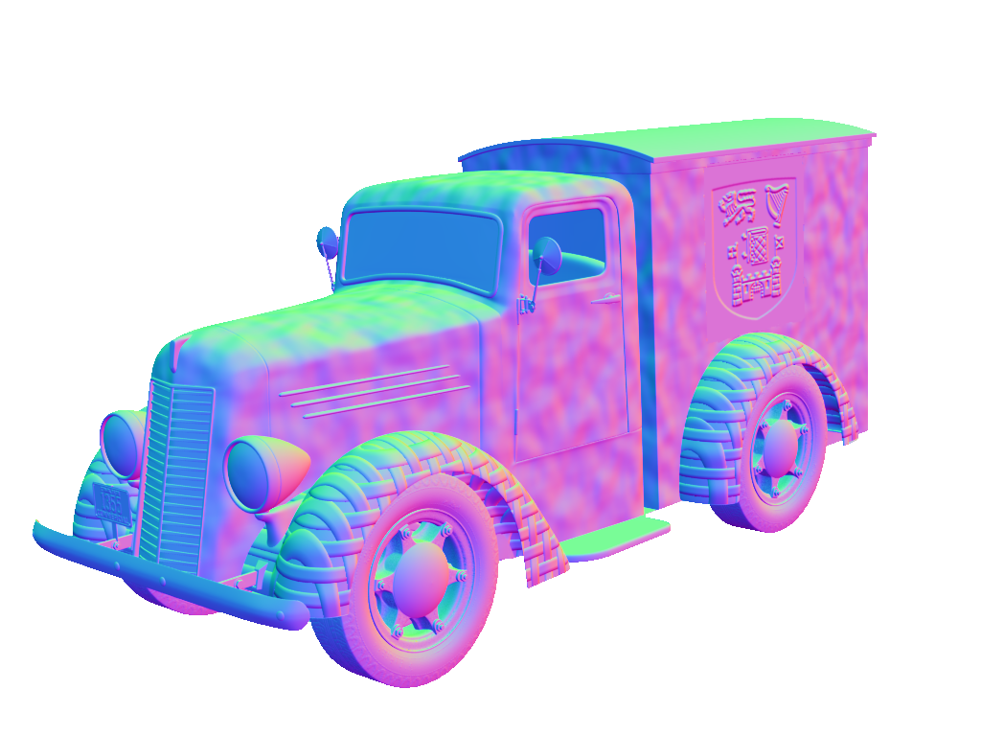


Goal
Grant real-time local shape modification in post-processing in a plausible way
Notes:
With our approach we want to provide the possibility to
Modify normals
And obtain a plausible result
Plausible results, but not neccesary accurate
Works in real time

Slide 7
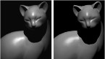
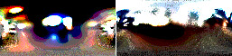
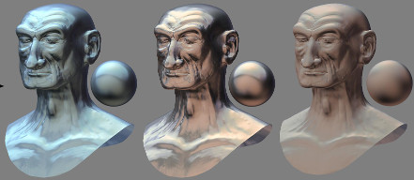
Lighting Reconstruction
A Signal-Processing Framework for Inverse Rendering [Ramammorthi et al 01]
Inverse Rendering is an ill-Posed Problem
Reflectance and Natural Illumination from a Single Image [Lombardi et al 12]
Statistical BRDFs and a low detail lighting
MatCap Decomposition for Dynamic Appearance Manipulation [Zubiaga et al 15]
Modify lighting and material from MatCaps
Notes:
The first idea would be to reconstruct llighting
Ramammorthi describe this problem as ill-posed in the general case, assumptions are neede to recover them
For example Lombardi uses natural statists and low entropy to recover complex statisic BRDFs and degenerated environment lighting
Contrary we follow the approach of our previous work where we manipulate material and lighting from a shaded sphere without decoupling those components
We do modification of appearance not physically based rendering

Slide 8
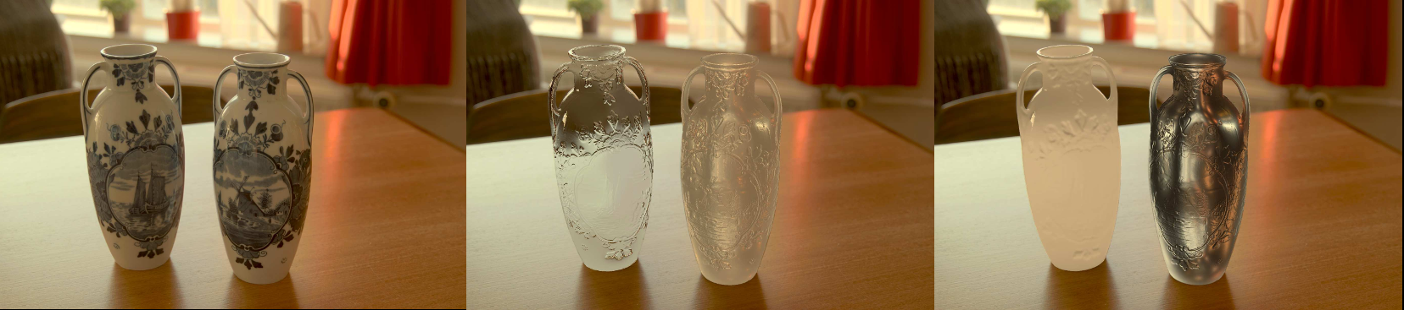
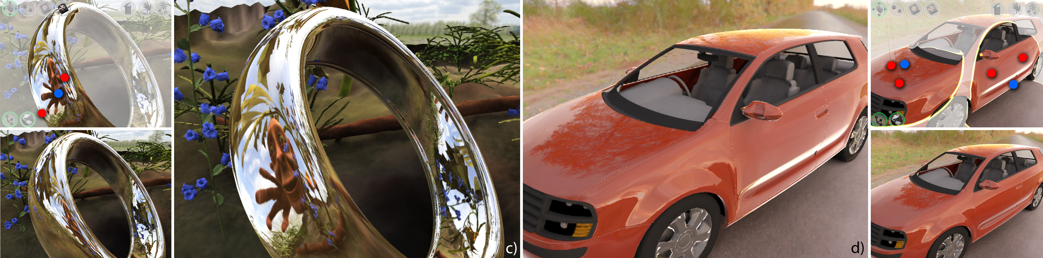
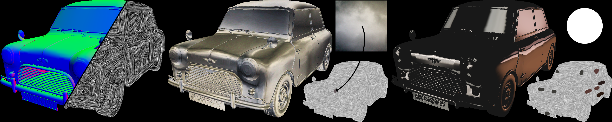
Appearance Manipulation
Image Based Material Editing [Khan et al 06]
Interactive Reflection Editing [Ritschel et al 09]
Surface flows for image-based shading design [Vergne et al 12]
Notes:
Different techniques has been proven useful to obtain a desired image appearance
Khan modify material appearance on HDR images
Ritschel modify reflection from the physical way in a 3D scen
Vergne uses normals and depth to deform reflections

Slide 9
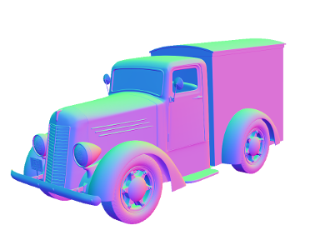

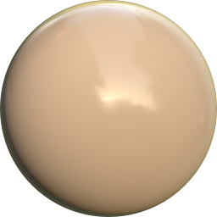


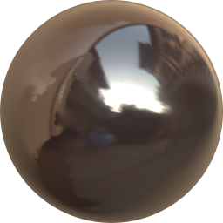
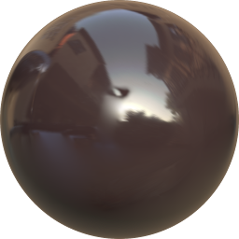
Main Idea
Reconstruct pre-filtered environment maps per object/material
Notes:
Our approach is to recover a PEM per object/material
We can see the recovered PEM for the body and both maduards
Naturally the new shading is obtained by a lookup on the recovered PEM
There is no need to decouple material and lighting

Slide 10
Frequency-depedent Reconstruction Approach
Diffuse
Low-Frequency
Spherical Harmonics
Reflections
High-Frequency
Detailed PEM
Notes:
We are in the compositing stage, which implies that for an image we have
A diffuse shading
And a reflection shading
The diffuse shading contains low frequency content
It can be represent with spherical harmonics
Contrary reflection contains high frequency shading
In this case a detailed pem is needed

Slide 11
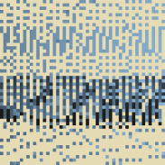
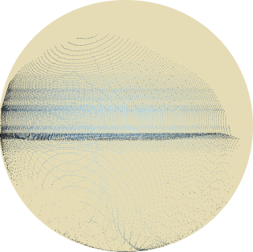
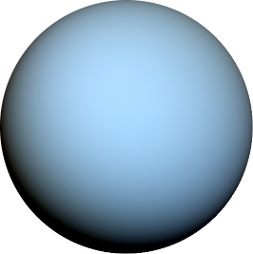
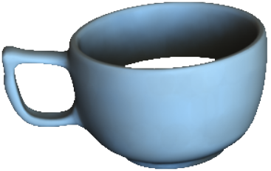
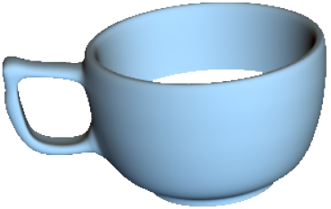

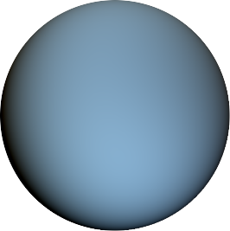
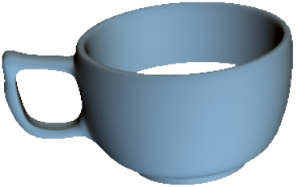

Diffuse Reconstruction (Low frequency)
Input
Diffuse Shading
Reconstruction
Spherical Harmonics
+1
Quadratic Programming
Fitting
0
Gauss Map
Diffuse reconstructed
Residuals corresponds to darkening by occlusion
Residuals can be reintroduced
Residuals
Diffuse PEM
-1
Mean Least Square
Notes:
In the diffuse case we want to reconstruct the spherical harmonics
We visualize the information in a Gauss map
Information is sparse (edges, occlusion, high curvature) and over constrained (occlusion) different colors for the same normals
We need to fit SH using the available information
A PEM can be reproduced using SH
Similarly we can shade the geometry of the input
Our approach guaratees that the differences to the original (Residuals) are negative
This is an additonal requierement in comparison to the classical LMS
The negative residuals corresponds to darkening due to occlusions that can be reintroduced
Quadratic minimization technique using given information
Introduce residuals with negative values constrains as they represent self-shadowing

Slide 12
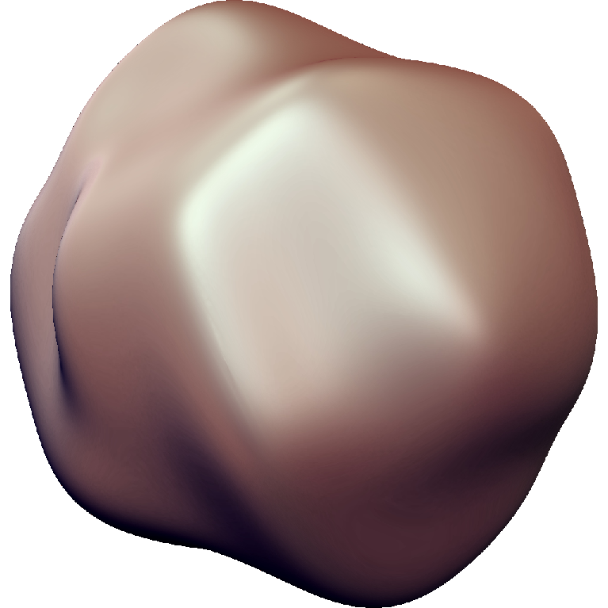






Reflection Reconstruction (High Frequency)
Notes:
Reflection shading contains high frequencies, SH would need too many factors
We need to preserve as much details from the input as possible
We project 4 neighbours pixels to a sphere depending on the reflected view vector
We fill its interior using spherical barycentric coordinates
Spherical polygons may overlap, we weight their shading by their size
The results haves part that cannot be filled depending on the geometry complexity of the input
It may contain as well regularities
We need to fill the missing part and regularize the results

Slide 13
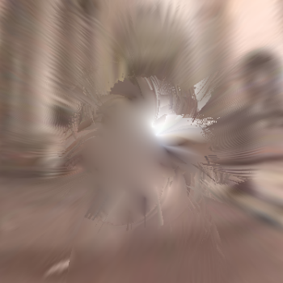
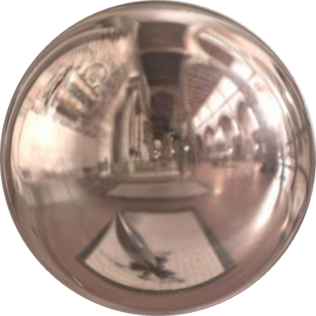
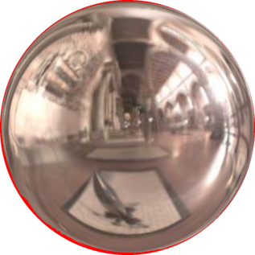
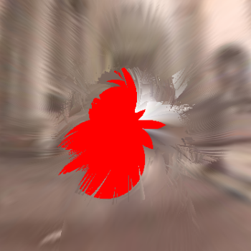
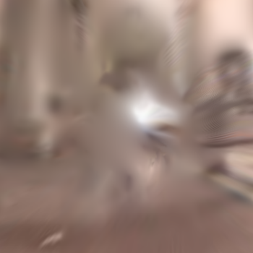

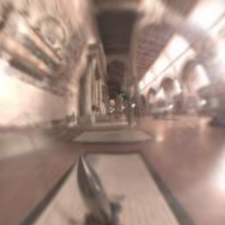
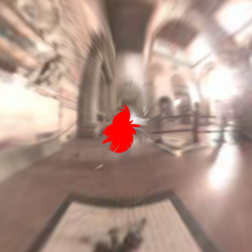
Reflection Reconstruction (High Frequency)
Input
Hole Filling
Front
Back
Regularize
Paraboloid Map
Notes:
First we use paraboloid map to store the pem to avoid distorsions
The missing part as filled using diffusion in a tessellated sphere
Then regularization is performed depending on the discotinues

Slide 14

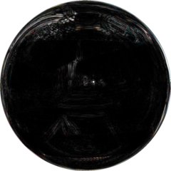


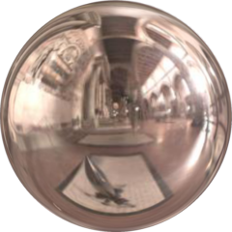


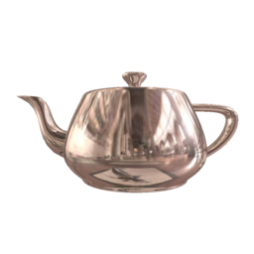
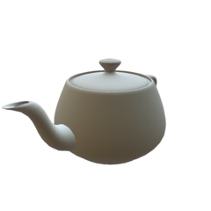
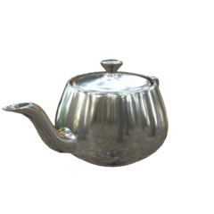


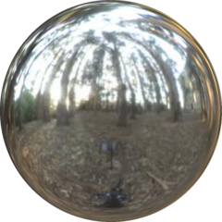
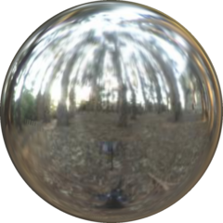

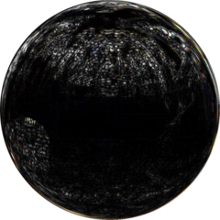
Recontruction Validation
Diffuse
Diff ×100
Reflections
Diff ×5
Input
Render
Recontructed
Input
Render
Recontructed
Diff ×10
Diff ×5
Notes:
We validate our technique by comparing our reconstruction to an original PEM and its Spherical Harmonics
We do a rendering using the SH of a PEM
We reconstruct the diffsuse PEM
The difference are really small
We follow the same process for the reflection reconstruction
We render using a PEM using a mirror like material
We reconstruc the high frequency PEM
Difference are bigger at the results remains accurate enough to look plausible

Slide 15


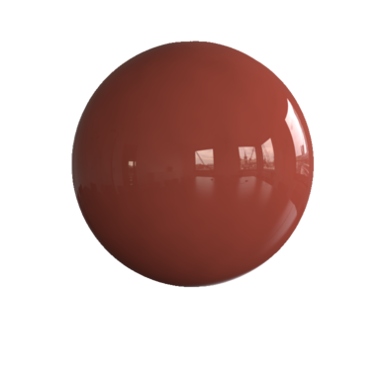
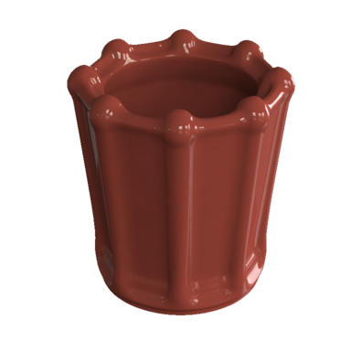







Reconstruction Validation
Perspective Sphere
Diffuse
Head
Vase
Shading
Shading
Shading
Normals
Normals
Reflection
Normals
Notes:
We know that our reconstruction depends on the geometry of the input
For this results global illumination techinques habe been used
We start by rendering a sphere in perspective projection
The diffuse and reflection reconstruct will be used to reference
A head model then is used
We cna that the result is less sharp
Now a vase with more interreflections
The reconstruction have for irregularities and the diffuse red interreflections are recovered

Slide 16














Re-Compositing
Diffuse
Original
Reconstructed
Recomposited
Reflection
Occlusion
Notes:
Reconstruction is used with the original normal to have a plausible shading when varyng normals
We first take separately diffuse and reflection
We see the result directly reconstructed
That defers from the recomposited one
Firs for the diffuse part we use diffuse occlusion to reintroduce darkening
Second for the reflection component we preserve the original values in the positions that are reflection occlusion
Finally we can see the difference between the original and the recompositing head

Slide 17


Results: Normal Modification Tools
Notes:
We show a few techniques to modify normals
Embossing
Bump mapping
Smoothing
Another normal map

Slide 18



Results: Normal Modification Tools
Ours
Ground Truth
Ours
Ground Truth
Notes:
This variations are similar to the rsults obtained by global illumination techniques
They still looks plausible with more complex geometry

Slide 19






Results: Complex Scenes
Specular Shading
Diffuse Shading
Normal
Ambient Occlusion
Specular Occlusion
Surface ID
Notes:
Complex scenes are essily manipulated
Here we show the buffers used for our technique
Inter-reflections are well preserved in recovered pre-filtered environment maps (Table-Top + Truck)

Slide 20

Results: Complex Scenes
Notes:
Inter-reflections are well preserved in recovered pre-filtered environment maps (Table-Top + Truck)

Slide 21

Results: Complex Scenes
Notes:
Inter-reflections are well preserved in recovered pre-filtered environment maps (Table-Top + Truck)

Slide 22

Results: Complex Scenes
Notes:
Inter-reflections are well preserved in recovered pre-filtered environment maps (Table-Top + Truck)

Slide 23










Results: Complex Scenes
Notes:
Inter-reflections are well preserved in recovered pre-filtered environment maps (Table-Top + Truck)

Slide 24

Results: Complex Scenes
Notes:
Inter-reflections are well preserved in recovered pre-filtered environment maps (Table-Top + Truck)

Slide 25
Discussion
Limitations
Conclusion
Plausible pre-filtered env. maps are sufficient to modify local shape
Restricted to opaque object
Reconstruction is limited by the geometry complexity
We are limited to modify but we cannot displace vertices (No visibility effects)

Slide 26
Discussion
Future Work
Conclusion
Plausible pre-filtered env. maps are sufficient to modify local shape
Extension to spatially varying reflectance
Get more invovled into the render outputs
Modify pre-filetred environment maps to mimic variation on material

Slide 27
Thank you

